Slide 1

FEEDBACK ON
FINVIZ BOT(GROUP 10)
GROUP 12
AVI MALHOTRA
SYED AMMAD SOHAIL
MOIZ SHAIKH

Slide 2

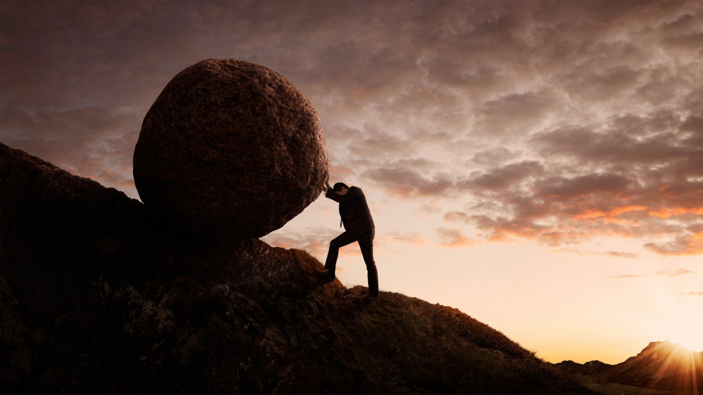
STRENGTHS
1
Thorough research informed comprehensive scenario development.
2
Realistic scenarios demonstrated understanding of existing customer needs.
3
Leveraged existing BMO services to replicate familiar experiences.

Slide 3
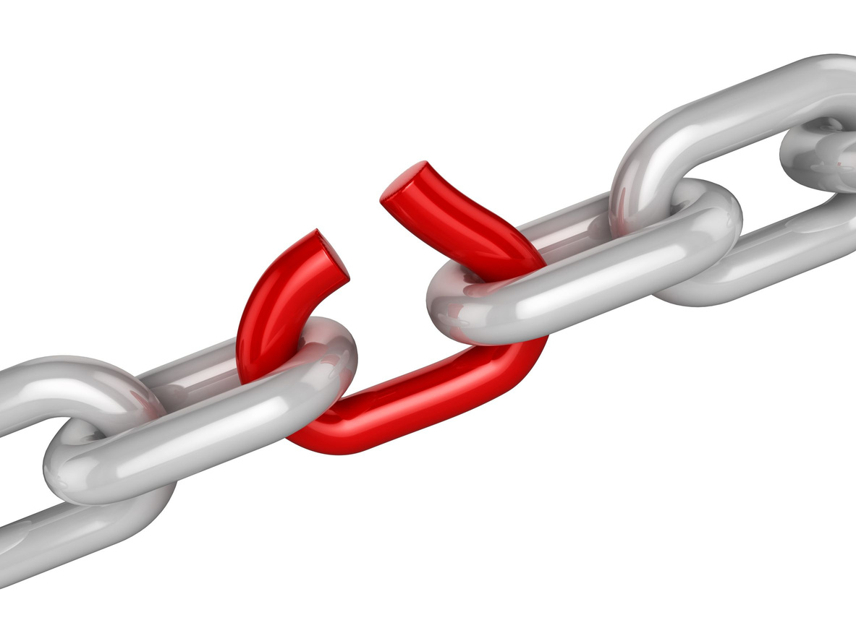

WEAKNESS
1
Scenarios and data sources not integrated for unified user workflow.
2
Rule based investment recommendations lack personalization capabilities.

Slide 4

SUGGESTIONS
1
Connect related scenarios and integrate underlying data sources.
2
Show more graphs throughout the code (Incorporated by Group 10)
3
Forecast for longer period ahead (Incorporated by Group 10)

